Slide 1
Communicating Help for Households and Cost of Living Payments
Updated stakeholder toolkit June 2023 including:
- social media copy and assets in English and Welsh - newsletter copy, and FAQs
- printable PDF for stakeholders
- easy read assets
- BSL YouTube video
Contact external.affairs@dwp.gov.uk for more information

Slide 2
How to talk about Help for Households and the Cost of Living Payments with your customers
​ This toolkit provides an update on the latest £150 Disability Cost of Living Payment. It sets out:
- what the different payments are and the payment windows
- who is eligible for the payments​
- how stakeholders can support their customers
Contact external.affairs@dwp.gov.uk for more information

Slide 3
Cost of living payment windows at a glance
Exact payment windows and qualifying periods for eligibility will be announced in due course but are designed to ensure a consistent support offer throughout the year. Payment windows will be broadly as follows:
Which payment? | How much? | When?
First 2023/24 Cost of Living Payment | £301 | Between 25 April and 17 May 2023
2023 Disability Payment | £150 | Between 20 June and 4 July 2023
Second 2023/24 Cost of Living Payment | £300 | Autumn 2023
2023 Pensioner Payment | £300 | During Winter 2023/24
Third 2023/24 Cost of Living Payment | £299 | During Spring 2024
Click here for the newsletter copy and poster, and translated versions in Wels

Slide 4
Help for Households - What people need to know
Millions of households on means-tested benefits, including tax credits, will receive up to three Cost of Living Payments over 2023 to 2024.
This includes all eligible households receiving the following benefits: Universal Credit, Income-based Jobseekers Allowance, Income-related Employment and Support Allowance, Income Support, Pension Credit, Working Tax Credit and Child Tax Credit.
The first payment of £301 was made between 25 April and 17 May with the second payment of £300 due to be made in the Autumn 2023, and the third payment of £299 due to be made in the Spring of 2024.
Payments will be made separately from benefits and automatically via usual payment methods – people do not need to contact HMRC or DWP or apply for the payment.
Those who are eligible for the £301 Cost of Living Payment solely through tax credits and are not eligible through DWP means-tested benefits, were paid by HMRC between 2 and 9 May. The payment will have appeared in customers’ bank accounts with the reference ‘HMRC COLS’, referencing Cost of Living Support.
An extra £150 payment to people on qualifying disability benefits will be paid between 20 June and 4 July.
There will also be an extra £300 for pensioner households paid as an increase to their winter fuel payment to be paid in Winter.

Slide 5
2023 Disability Cost of Living Payment

Slide 6
Frequently asked questions
The following top-level FAQs may answer any questions:
How do I apply for the Disability Cost of Living Payment?
You do not need to apply. If you’re eligible, you’ll be paid automatically in the same way you usually get your benefit or tax credits. This includes if you’re found to be eligible at a later date.
Will these benefits affect my other payments?
These payments are not taxable and will not affect the benefits or tax credits you get.
How will I know if I’m eligible? What are the qualifying dates and requirements?
You may be entitled to a Disability Cost of Living Payment of £150 if you’re getting any of any of the following benefits:
Attendance Allowance
Constant Attendance Allowance
Disability Living Allowance for adults
Disability Living Allowance for children
Personal Independence Payment
Adult Disability Payment (in Scotland)
Child Disability Payment (in Scotland)
Armed Forces Independence Payment
War Pension Mobility Supplement
You must have received a payment of one of these benefits for 1 April 2023 to get the Disability Cost of Living Payment. If you are later found to be entitled and have received a payment for the 1 April 2023, a Disability Cost of Living payment will be made to you automatically.
What happens if I’m waiting for a decision on a benefit entitlement?
If this decision includes an award which covers 1 April 2023, the Disability Cost of Living Payment will be paid automatically.
There is more than one disabled person in my household – what happens then?
The Disability Cost of Living Payment is assessed on an individual basis. If a household has multiple disabled occupants, each eligible person will get a Disability Cost of Living Payment.

Slide 7
Frequently asked questions cont.
I haven’t got my Disability Cost of Living Payment what do I do?
The disability payment will start on 20 June 2023 and may take a few weeks before you see it in your account.
Most payments will be made by 4 July 2023. From the 5 July 2023 you will be able to report a missing cost of living payment online: www.gov.uk/guidance/cost-of-living-payment You will not be able to report it as missing before this date as we will still be making some payments.
How can I tell if I’ve received my Disability Cost of Living payment? How will it show in my bank account?
Those who qualify for the disability payment will get their £150 in the same way they get their regular benefit payments. This will appear as your National Insurance Number followed by ‘DWPCOL’ in your bank account.
If I receive the Disability Cost of Living payment, am I still entitled to the other means-tested Cost of Living payments? You may be able to get up to 5 payments to help with the cost of living if you’re getting certain benefits or tax credits.
£301 Cost of Living Payment – April 2023
£150 Disability Cost of Living Payment – June 2023
£300 Cost of Living Payment – Autumn 2023
Pensioner Cost of Living Payment – Winter 2023/24
£299 Cost of Living Payment – Spring 2024
These payments are not taxable and will not affect the benefits or tax credits you get.
Receiving the Disability Cost of Living payment does not affect your entitlement to other means tested Cost of Living payments.
I have applied for a disability benefit but have not yet been assessed. Will I still receive a Disability Cost of Living Payment?
After assessment, if the final decision includes an award which covers 1 April 2023, the Disability Cost of Living Payment will be paid automatically.
Do I need to do anything to get this money?
You do not need to apply, payments will be made automatically to those who are eligible.
What happens if I don’t receive the money by the beginning of July?
Most payments will be made by 4 July 2023. If you think you are eligible but haven’t received anything by 5 July you can report missing payments online: www.gov.uk/cost-of-living-payment

Slide 8
Frequently asked questions cont.
I am currently asking for a reconsideration on/ appealing my disability benefit decision. If I’m successful, will I get a Disability Cost of Living Payment?
If the final decision includes an award which covers 1 April 2023, the Disability Cost of Living Payment will be paid automatically.
I am in receipt of the higher/enhanced rate of the mobility component [of Disability Living Allowance or Personal Independence Payment] or Armed Forces Independence Payment or the War Pensioner Mobility Supplement and use this to lease a vehicle from Motability. Will I be entitled to a Disability Cost of Living Payment?
Yes. You will still be eligible for a Disability Cost of Living Payment as long as the mobility component was being paid and in place on the 1 April 2023.
I have been told I am not entitled to a Cost of Living Payment, how do I appeal the decision?
The Disability Cost of Living Payment itself cannot be appealed. You would need to ask for a mandatory reconsideration or appeal in relation to your eligibility to the disability benefit and have a payment made that covers the date of the 1 April 2023.
When will the second part of the £900 Cost of Living Payment be paid?
The second £300 payment will be paid during autumn 2023 for most people if eligible.
Where can I access further cost of living advice?
For further information about the support available, please visit: www.gov.uk/guidance/cost-of-living-payment

Slide 9
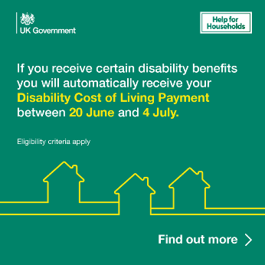
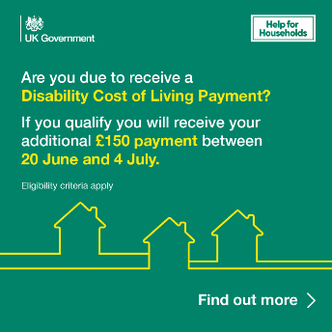
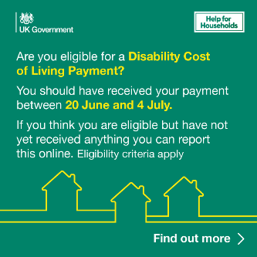
Social media assets
Example asset | Suggested supporting copy
 | If you receive certain disability benefits you could be due an additional Cost of Living Payment.
 | From 20 June those who qualify will automatically receive a Disability Cost of Living Payment.
To use from 5 July
 | You can now report missing Disability Cost of Living Payments online.
Download social assets in English and
Welsh from our online toolkit.

Slide 10
Newsletter copy
Newsletter copy: This is for stakeholders to include in their own channels to members of the public.
Millions of disabled people will receive further support from government to ease financial pressures during the rising cost of living More than six million disabled people in the UK will receive a one-off £150 Disability Cost of Living Payment. Those being paid a disability benefit that qualifies them for the payment will receive it automatically, with most payments being made between 20 June 2023 and 4 July 2023. To be eligible for the Disability Cost of Living Payment you must be entitled to one or more of: Disability Living Allowance Personal Independence Payment Attendance Allowance Scottish Disability Benefits (Adult Disability Payment and Child Disability Payment) Armed Forces Independence Payment Constant Attendance Allowance War Pension Mobility Supplement Recipients of these benefits must have received a payment (or later received a payment) for 1 April 2023. For those who were awaiting confirmation of their entitlement to disability benefits on 1 April, or who are waiting to be assessed for eligibility to receive disability benefits, the process may take longer, but payments will still be automatic. The Disability Cost of Living Payment will be paid separately to benefit payments and will appear in accounts with the account holder’s National Insurance number and DWPCOL. Customers do not need to contact DWP or apply for any of these payments, they will be made automatically into the accounts of those eligible. For more information, visit: Cost of Living Payments 2023 to 2024 - GOV.UK (www.gov.uk)

Slide 11
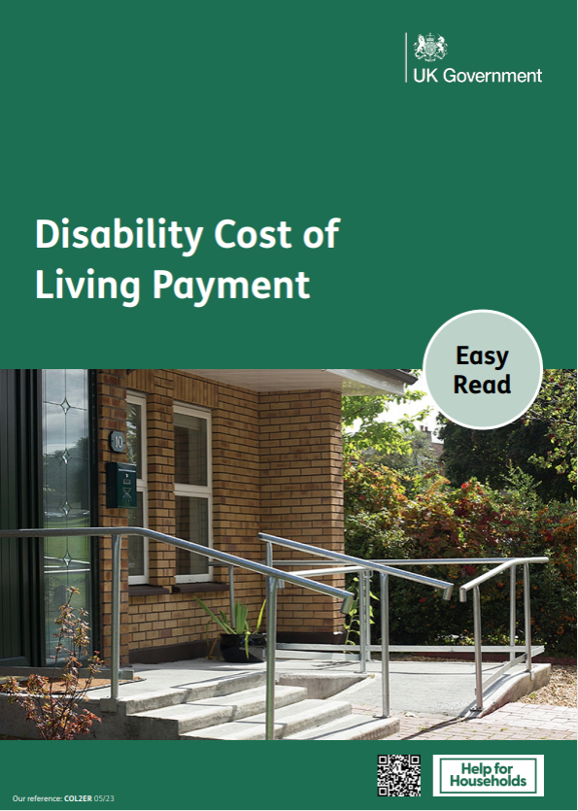
Accessible products
Easy read / BSL video
BSL information video available at:
Disability Cost of Living Payment: information for customers - YouTube
Download the Easy Read information in English and Welsh.

Slide 12
Useful links
Download files to support customers here
Link to the gov.uk guidance page
Use the HM Gov benefits checker to find out what you might be entitled to
BSL information on YouTube
Use an independent benefits calculator to find out what benefits you could get
Help for Households campaign website
You may be able to get other kinds of support, including:
Help from the Household Support Fund from your local council in England
The Discretionary Assistance Fund in Wales
A Crisis Grant or Community Care Grant in Scotland
Discretionary Support or a Short-term Benefit Advance in Northern Ireland
Find out what other benefits and financial support you might be able to get to help with your living costs.
Use an independent benefits calculator to find out what benefits you could get.

